Slide 1
Scan Conversion
10/16/2018

Slide 2
Scan Converting Lines
Line Drawing
First problem statement: Draw a line on a raster screen between two points
Why is this a difficult problem?
What is “drawing” on a raster display?
What is a “line” in raster world?
Efficiency and appearance are both important
Problem Statement
Given two points P and Q in the XY plane, both with integer coordinates, determine which pixels on a raster screen should be drawn in order to best approximate a unit-width line segment starting at P and ending at Q
10/16/2018

Slide 3
What is Scan Conversion?
Final step of rasterization (the process of taking geometric shapes and converting them into an array of pixels stored in the framebuffer to be displayed) – converting from “random scan”/vector specification to a raster scan where we specify which pixels are drawn based on a stored array of primitives.
Takes place after clipping occurs
All graphics packages do this at end of the rendering pipeline
Takes triangles (or higher-order primitives) and maps them to pixels on screen
For 3D: rendering also takes into account other processes, like lighting and shading, but we’ll focus first on algorithms for line scan conversion
10/16/2018

Slide 4
Scan-converting a Line: Finding the next pixel
Special cases:
Horizontal Line:
Draw pixel P and increment x coordinate value by 1 to get next pixel.
Vertical Line:
Draw pixel P and increment y coordinate value by 1 to get next pixel.
Diagonal Line:
Draw pixel P and increment both x and y coordinate by 1 to get next pixel.
What should we do in the general case?
For slope <= 1, increment x coordinate by 1 and choose pixel on or closest to line. Slopes in other octants by reflection (e.g., in second octant, increment Y)
But how do we measure “closest”?
10/16/2018

Slide 5


Vertical Distance
Why can we use vertical distance as a measure of which point (pixel center) is closer?
… because vertical distance is proportional to actual distance
Similar triangles show that true distances to line (in blue) are directly proportional to vertical distances to line (in black) for each point
Therefore, point with smaller vertical distance to line is closest to line
10/16/2018

Slide 6
Vertical Distance
Basic Algorithm:
Find equation of line that connects points P and Q
Draw pixel P and increment x coordinate value by 1 to get next pixel.
Vertical Line:
Draw pixel P and increment y coordinate value by 1 to get next pixel.
Diagonal Line:
Draw pixel P and increment both x and y coordinate by 1 to get next pixel.
What should we do in the general case?
For slope <= 1, increment x coordinate by 1 and choose pixel on or closest to line. Slopes in other octants by reflection (e.g., in second octant, increment Y)
Use vertical distance to measure “closest”
10/16/2018

Slide 7
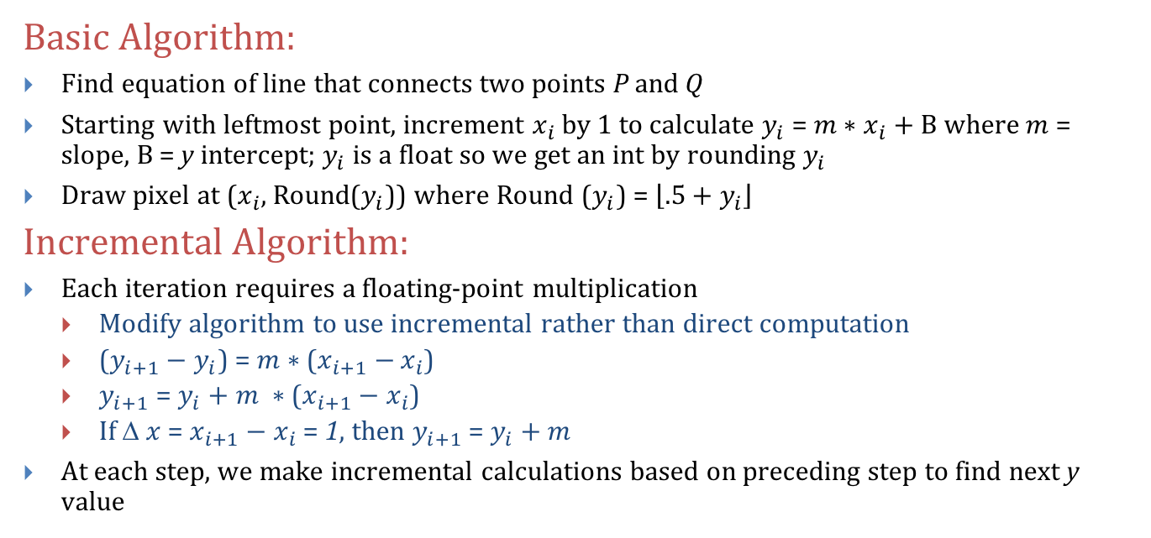
Strategy 1 – Incremental Algorithm (1/3)
Basic Algorithm:
Find equation of line that connects two points P and Q
Starting with leftmost point, increment $x_{i}$ by 1 to calculate $y_{i}$ = $m∗x_{i}+B$where $m$= slope, $B$ = y intercept; $y_{i}$ is a float so we get an int by rounding $y_{i}$
Draw pixel at ($x_{i}$, Round($y_{i}$)) where Round ($y_{i}$) = $\left\lfloor .5+y_{i}\right\rfloor$
Incremental Algorithm:
Each iteration requires a floating-point multiplication
Modify algorithm to use incremental rather than direct computation
($y_{i+1}−$ $y_{i}$) = $m∗$($x_{i+1}−$ $x_{i}$)
$y_{i+1}$= $y_{i}+m ∗$($x_{i+1}−x_{i}$)
If Δ $x$ = $x_{i+1}−x_{i}$ = 1, then $y_{i+1}$ = $y_{i}+m$
At each step, we make incremental calculations based on preceding step to find next y value
10/16/2018

Slide 8




Strategy 1 – Incremental Algorithm (2/3)
10/16/2018

Slide 9
Strategy 1 – Incremental Algorithm (3/3) - Issues
void Line(int x0, int y0, int x1, int y1) {
int x, y;
float dy = y1 – y0;
float dx = x1 – x0;
float m = dy / dx;
y = y0;
for (x = x0; x < x1; ++x) {
WritePixel( x, Round(y) );
y = y + m;
}
}
Since slope is fractional, need special case for vertical lines (dx = 0)
Rounding takes time
10/16/2018

Slide 10
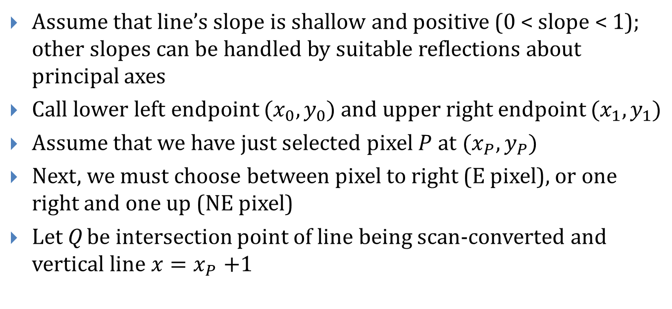
Strategy 2 – Midpoint Line Algorithm (1/3)
Assume that line’s slope is shallow and positive (0 < slope < 1); other slopes can be handled by suitable reflections about principal axes
Call lower left endpoint $(x_{0},y_{0})$ and upper right endpoint $(x_{1},y_{1})$
Assume that we have just selected pixel $P$ at $(x_{P},y_{P})$
Next, we must choose between pixel to right (E pixel), or one right and one up (NE pixel)
Let Q be intersection point of line being scan-converted and vertical line $x{=x}_{P}+1$
10/16/2018

Slide 11


Strategy 2 – Midpoint Line Algorithm (2/3)
NE pixel
Q
Midpoint M
Previous pixel
E pixel
10/16/2018

Slide 12


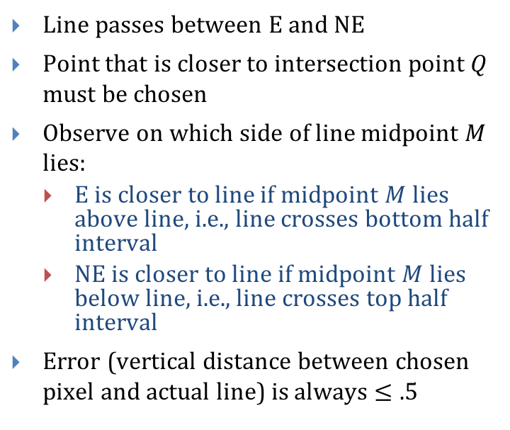
Strategy 2 – Midpoint Line Algorithm (3/3)
Line passes between E and NE
Point that is closer to intersection point $Q$ must be chosen
Observe on which side of line midpoint $M$ lies:
E is closer to line if midpoint $M$ lies above line, i.e., line crosses bottom half interval
NE is closer to line if midpoint $M$ lies below line, i.e., line crosses top half interval
Error (vertical distance between chosen pixel and actual line) is always $≤.5$
NE pixel
E pixel
For line shown, algorithm chooses NE as next pixel.
Now, need to find a way to calculate on which side of line midpoint lies
10/16/2018

Slide 13
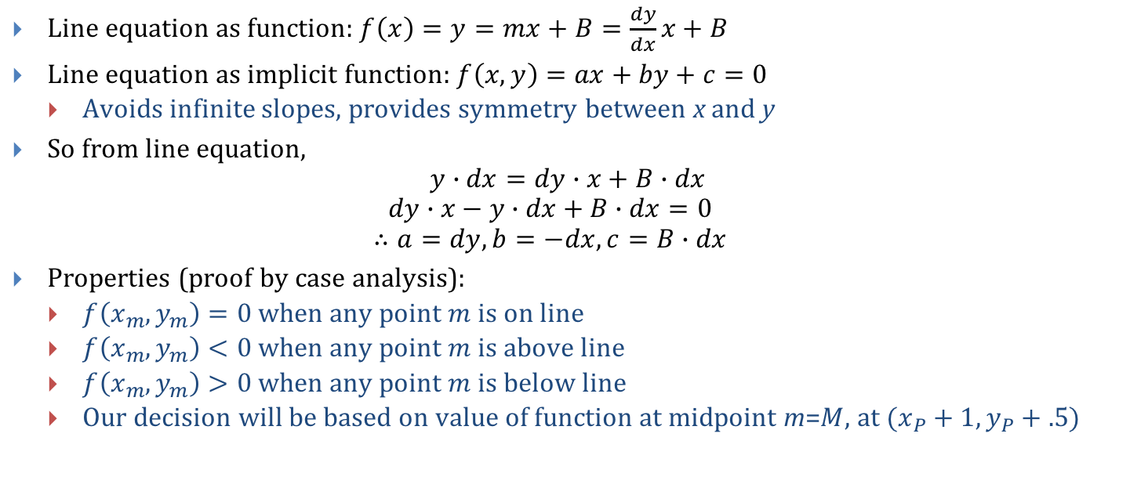
General Line Equation in Implicit Form
Line equation as function: $f\left(x\right)=y=mx+B=\frac{dy}{dx}x+B$
Line equation as implicit function: $f\left(x,y\right)=ax+by+c=0$
Avoids infinite slopes, provides symmetry between x and y
So from line equation,
$$y∙dx=dy∙x+B∙dx$$
$$dy∙x−y∙dx+B∙dx=0$$
$$∴a=dy, b=−dx,c=B∙dx$$
Properties (proof by case analysis):
$f\left(x_{m},y_{m}\right)=0$ when any point $m$ is on line
$f\left(x_{m},y_{m}\right)<0$ when any point $m$ is above line
$f\left(x_{m},y_{m}\right)>0$ when any point $m$ is below line
Our decision will be based on value of function at midpoint m=$M,$ at $(x_{P}+1, y_{P}+.5)$
10/16/2018

Slide 14
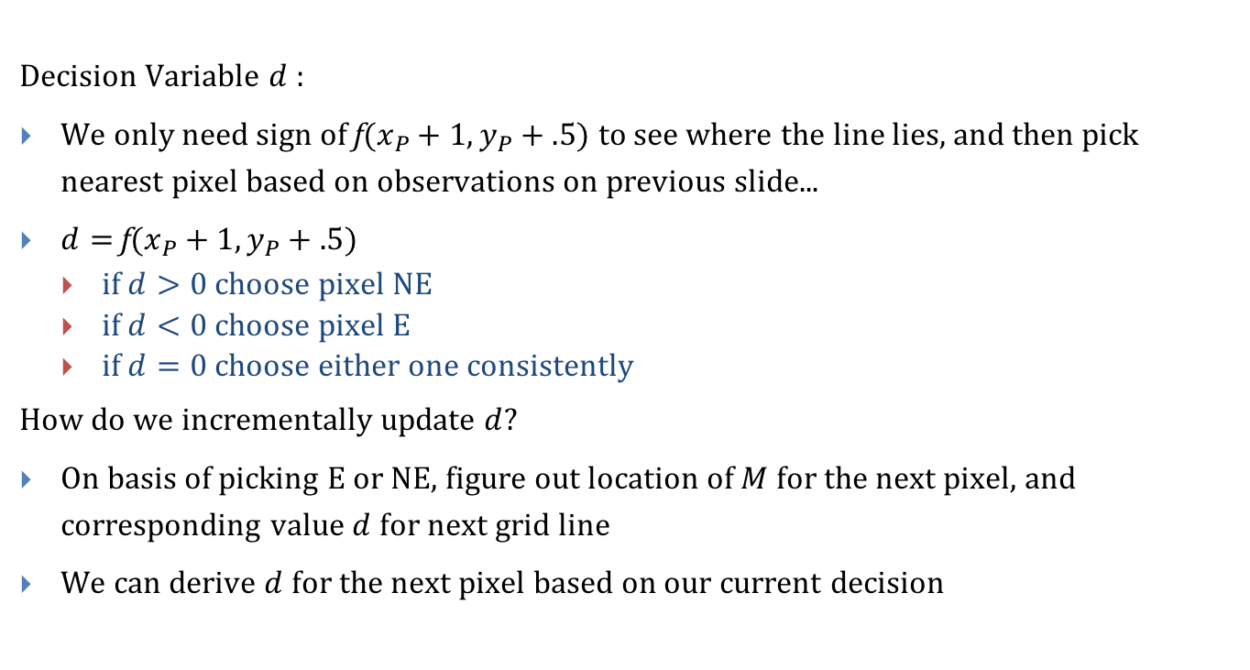
Decision Variable
Decision Variable $d$:
We only need sign of f$(x_{P}+1, y_{P}+.5)$ to see where the line lies, and then pick nearest pixel based on observations on previous slide...
$d=$f$(x_{P}+1, y_{P}+.5)$
if $d>0$ choose pixel NE
if $d<0$ choose pixel E
if $d=0$ choose either one consistently
How do we incrementally update $d$?
On basis of picking E or NE, figure out location of $M$ for the next pixel, and corresponding value $d$for next grid line
We can derive $d$for the next pixel based on our current decision
10/16/2018

Slide 15
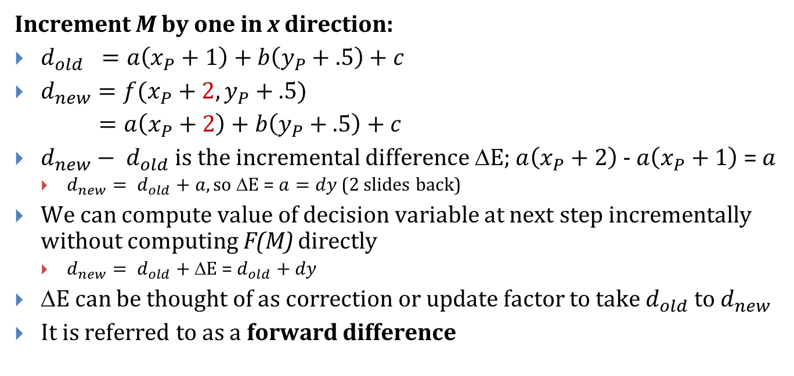
Incrementing Decision Variable if E was chosen:
Increment M by one in x direction:
$d_{old} =a\left(x_{P}+1\right)+b\left(y_{P}+.5\right)+c$
$d_{new}=f(x_{P}+2,y_{P}+.5)$
$=a\left(x_{P}+2\right)+b\left(y_{P}+.5\right)+c$
$d_{new}− d_{old}$ is the incremental difference ΔE; $a\left(x_{P}+2\right)$ - $a\left(x_{P}+1\right)$ = $a$
$d_{new}= d_{old}+a, so$ΔE = $a=dy$ (2 slides back)
We can compute value of decision variable at next step incrementally without computing F(M) directly
$d_{new}= d_{old}+$ ΔE = $d_{old}+dy$
ΔE can be thought of as correction or update factor to take $d_{old}$ to $d_{new}$
It is referred to as a forward difference
10/16/2018

Slide 16
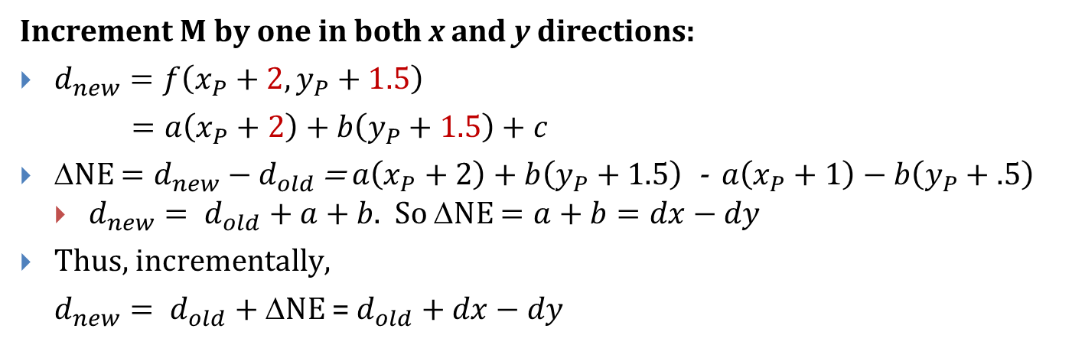
If NE was chosen:
Increment M by one in both x and y directions:
$d_{new}=f\left(x_{P}+2,y_{P}+1.5\right)$
$=a\left(x_{P}+2\right)+b\left(y_{P}+1.5\right)+c$
ΔNE $=d_{new}−d_{old}$ = $a\left(x_{P}+2\right)+b\left(y_{P}+1.5\right)$ - $a\left(x_{P}+1\right)−b\left(y_{P}+.5\right)$
$d_{new}= d_{old}+a+b\text{. }\text{So}$ΔNE $=a+b=dx−dy$
Thus, incrementally,
$d_{new}= d_{old}+$ΔNE = $d_{old}+dx−dy$
10/16/2018

Slide 17
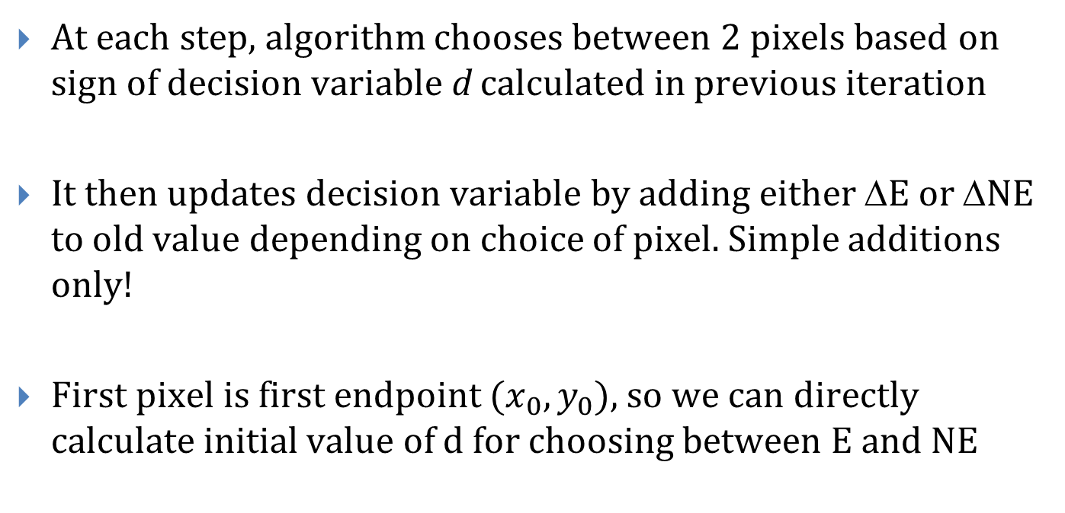
Summary (1/2)
At each step, algorithm chooses between 2 pixels based on sign of decision variable d calculated in previous iteration
It then updates decision variable by adding either ΔE or ΔNE to old value depending on choice of pixel. Simple additions only!
First pixel is first endpoint $(x_{0}, y_{0}),$so we can directly calculate initial value of d for choosing between E and NE
10/16/2018

Slide 18
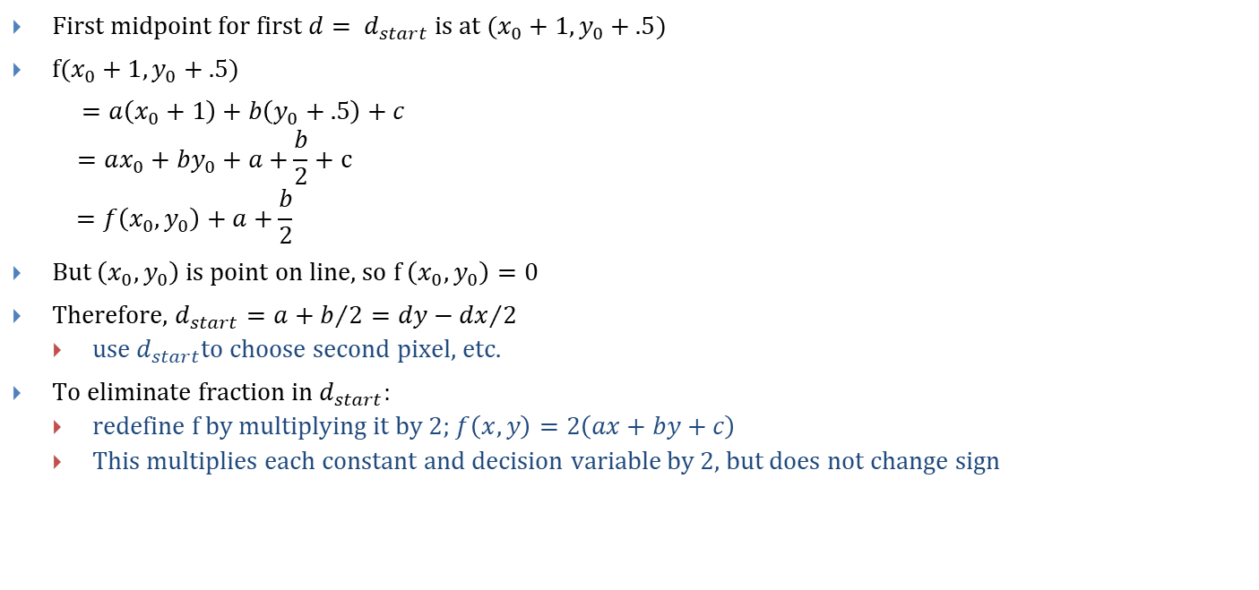
Summary (2/2)
First midpoint for first$d= d_{start}$ is at $(x_{0}+1, y_{0}+.5)$
$f(x_{0}+1, y_{0}+.5)$
$=a\left(x_{0}+1\right)+b\left(y_{0}+.5\right)+c$
$$=ax_{0}+by_{0}+a+\frac{b}{2}+c$$
$$=f\left(x_{0},y_{0}\right)+a+\frac{b}{2}$$
But $\left(x_{0},y_{0}\right)$is point on line, so f $\left(x_{0},y_{0}\right)=0$
Therefore, $d_{start}=a+b/2=dy−{dx}/2$
use $d_{start}$to choose second pixel, etc.
To eliminate fraction in $d_{start}$:
redefine f by multiplying it by 2; $f\left(x,y\right)=2\left(ax+by+c\right)$
This multiplies each constant and decision variable by 2, but does not change sign
10/16/2018

Slide 19

Finally, we have:
$d_{start}$ = 2a + b = 2dy - dx
ΔE = 2$a=2dy$
ΔNE $=2(a+b)=2(dy −dx$)

Slide 20
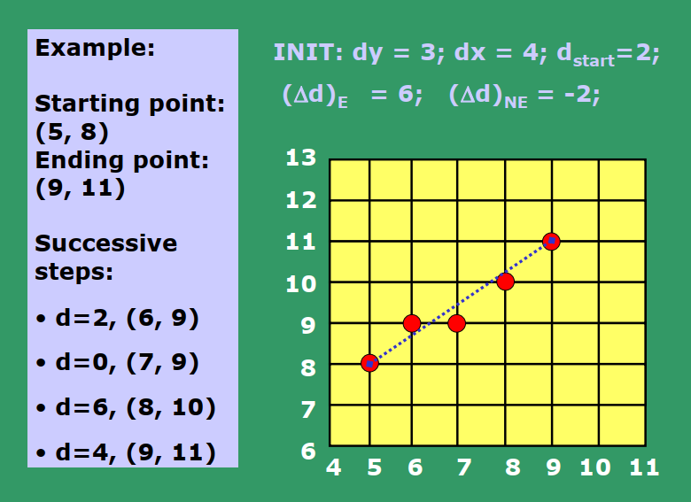

Slide 21
Example Code
void MidpointLine(int x0, int y0, int x1, int y1) {
int dx = (x1 - x0), dy = (y1 - y0);
int d = 2 * dy - dx;
int incrE = 2 * dy;
int incrNE = 2 * (dy - dx);
int x = x0, y = y0;
WritePixel(x, y);
while (x < x1) {
if (d <= 0) d = d + incrE; // East Case
else { d = d + incrNE; ++y; } // Northeast Case
++x;
WritePixel(x, y);
}
}
10/16/2018

